Slide 1
A MAJOR PROJECT ON DETECTION OF CYBERBULLYING ON SOCIAL MEDIA USING MACHINE LEARNING UNDER THE GUDIANCE OF DR T.S.MASTAN RAO
PRESENTED BY:
M.SHANMUKANJALI(197R1A05G9)
D.ARUN PRANEETH KUMAR(197R1A05D4)
P.VARSHEEK REDDY(197R1A05H6)

Slide 2
ABSTRACT:
In the research of online social networks, detection of anonymous user behavior, detection of offensive data, etc. are traditional and important research works. This project is focused on the detection of offensive data, and bully statements in shared data of the social networks. For this system, using Machine Learning algorithms with Text Mining concepts predicted the offensive data to get more accurate results. This project proposed a system of “Cyber Bullying Detection (CBD) in Social Networking” for predicting bully data. This project is used two datasets, namely, ‘Hate Speech and Offensive Language Dataset’ and ‘Harassment-Corpus Dataset’. This project used three Machine Learning classifiers such as Support Vector Machine (SVM), Random Forest (RF), Naïve Bayes (NB), and Neural Network (NN) Algorithms and calculated performance results for comparing the performance for both datasets. To demonstrate this system designed and developed a Python-based Django web application and showed the results.

Slide 3
Existing System:
In current trend many social networking sites created and providing services of communications, multi-media services, e-commerce etc immensely. For example twitter social media provide major services of micro-blogging massively, it has more than 700 million users and 400 million micro-blogs produces per day. According to research survey many more than 30% of dummy or duplicate or fake accounts are present in all social media services like twitter, facebook, sina etc. But in the current social sites not focus on services like tracking the user behavior of anonymous behavior. In current system, social network sites need to focus the user microblogs and need to capture the user behavior whether his/she anonymous user or not. Few surveys’providing concepts to tracking the attackers like using profile matching techniques and network based techniques etc. But in real-time to apply those concepts in social network is less practical.

Slide 4
Proposed System :
The proposed system ‘Cyber Bullying Detection (CBD) in Social Networking’ is to identify the bully or offensive statements using a classification model. Based on this requirement, the proposed architecture is designed based on two flows, namely, classification analysis and user side prediction. Based on the project requirement, this architecture is designed . This section described the workflow of the architecture and project main modules. The main purpose of the CBD system is to identify the bully or offensive statements using Machine Learning algorithms. To achieve this requirement, need to implement the classification analysis. The classification analysis is the process of conducting training and testing process for calculating the performance measures between various Machine Learning algorithms. Based on these requirements, the proposed architecture is designed with two flows, namely, classification analysis which is taken care of by the admin and user side prediction, these two flows are represented in two different color formats.

Slide 5
System Requirements:
Hardware Requirements:

Slide 6

Software Requirements:

Slide 7
DISADVANTAGES:
Techniques which are used in the existing system are not automated they need time to process request and update response.
Social networking and chatting sites require automated detecting and processing methods.

Slide 8
ADVANTAGES:
Cyberbullying detection process is automatic and time taken for detection is less and it works on the live environment.
The latest machine learning models are used for training models that are accurate.

Slide 9
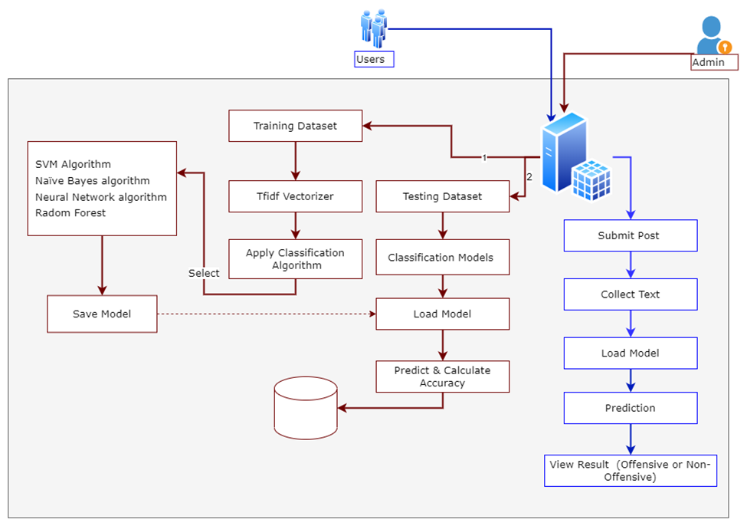
ARCHITECTURE:

Slide 10
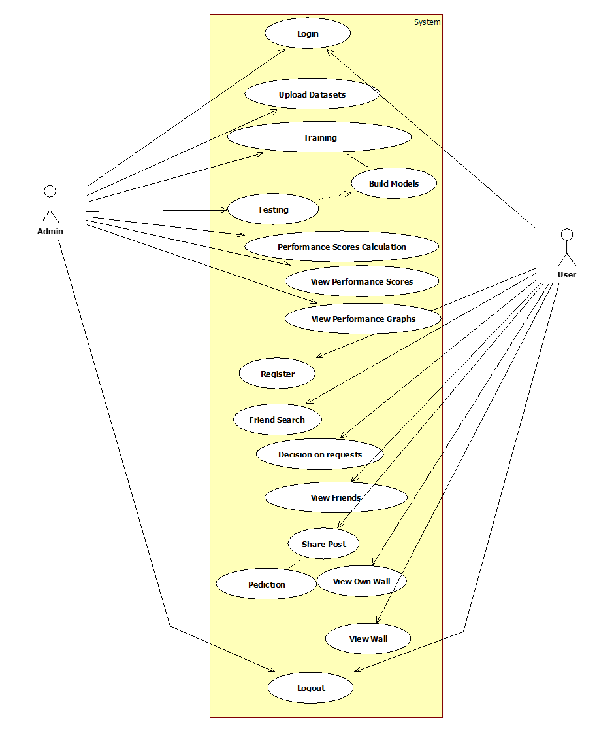
UML DIAGRAMS:(use case diagram)

Slide 11
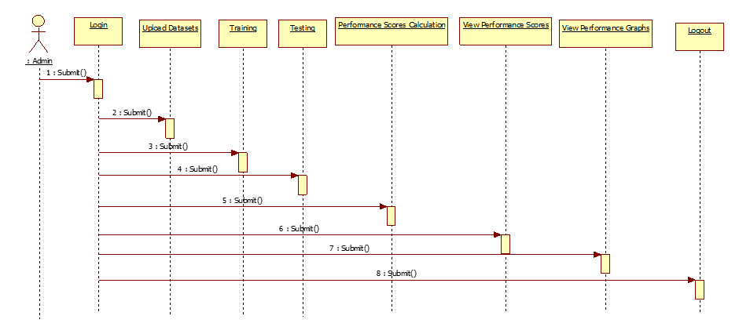
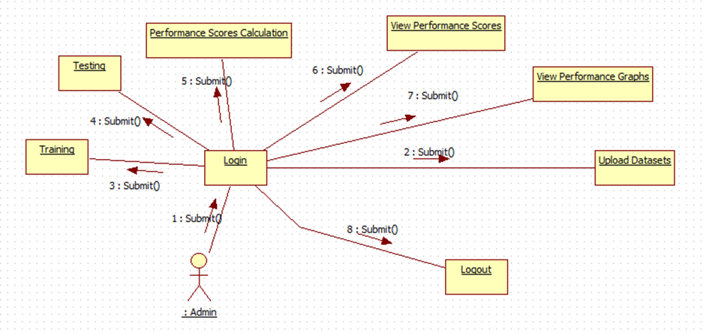
ADMIN SEQUENCES: ADMIN COLLABORATION DIAGRAM:

Slide 12
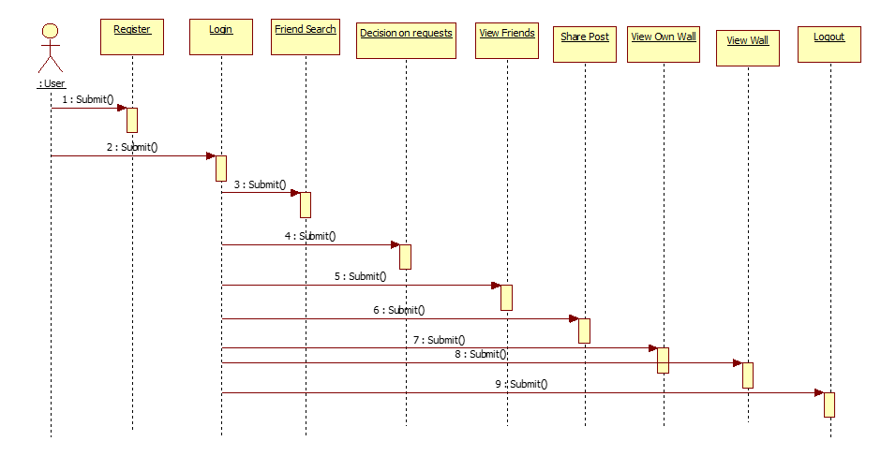
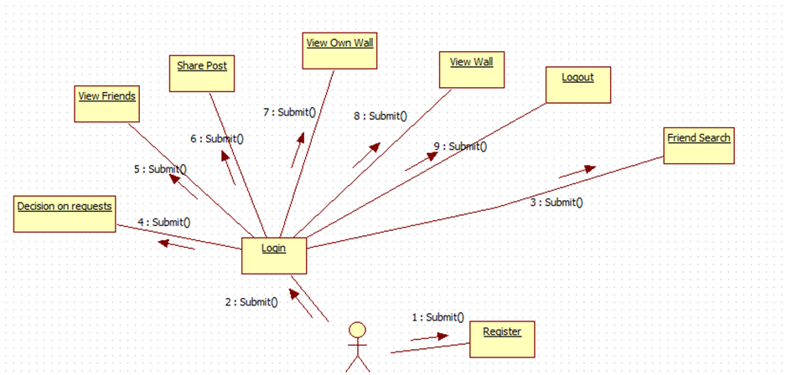
USER SEQUENCE: USER COLLABORATION DIAGRAM:

Slide 13
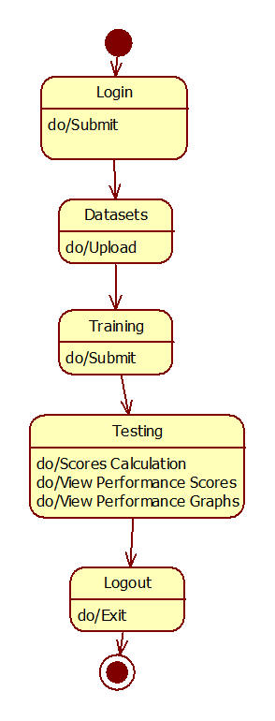
ADMIN STATECHART:

Slide 14
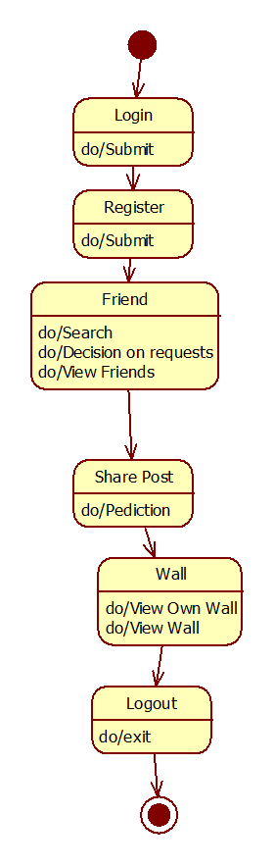
USER STARTCHART:

Slide 15
Conclusion:
This work aimed to contribute to the cyberbullying detection problem. we used to collect data from diﬀerent data providers and to train classiﬁers.
These classiﬁers consider the cyberbullying detection problem from diﬀerent perspectives including text exchanged between people, age, gender and personality of eventual bullyers.
These diﬀerent perspectives can help to proﬁle bullyers and hence to improve the early cyberbullying detection.
In future we are planning to design a framework for automatic detection and classiﬁcation of cyber-bullying by using deep learning algorithms.

